Slide 1


Course Name object oriented analysis and design
CSC 2210
(Undergraduate)
Software engineering (Undergraduate)
Chapter 3 USE Case Diagram
MOHAIMEN-BIN-NOOR
Assistant Professor, CS
mohaimen.niloy@aiub.edu

Slide 2
Objectives
Chapter 3: Use Case Diagram
MOHAIMEN-BIN-NOOR
S.2
MM
Capture the intended behavior of the system.
Without specifying how that behavior is implemented.
Use cases provide a way for developers to come to a common understanding with your system's end users and domain experts.
In addition, use cases serve to help validate your architecture and to verify your system as it evolves during development.
Use cases specify WHAT are the externally visible behaviors; they DO NOT dictate HOW that behavior will be carried out internally.

Slide 3

Use Case
Chapter 3: Use Case Diagram
MOHAIMEN-BIN-NOOR
S.3
MM
Use cases specify desired behavior.
A use case is a description of a set of sequences of actions, including variants (alternatives), a system performs to yield an observable result of value to an actor.
The names of use cases are always written in the form of a verb followed by an object.
Each sequence represent an interaction of actors with the system.
Describing the flow of events within the use case.
Can be done in natural language, formal language or pseudo-code.
Includes:
How and when the use case starts and ends;
When the use case interacts with actors and what objects are exchanged;
The basic flow and alternative flows of the behavior.

Slide 4
Actor
Chapter 3: Use Case Diagram
MOHAIMEN-BIN-NOOR
S.4
MM
An actor represents a set of roles that users of use case play when interacting with these use cases.
Actors can be human or automated systems.
For example, in modeling a bank, processing a loan involves, among other things, the interaction between a customer and a loan officer.
Actors are not part of the system.
A system can be an Actor of other systems

Slide 5
Relationships
Chapter 3: Use Case Diagram
MOHAIMEN-BIN-NOOR
S.5
MM
Association
Actor to Use Case
Generalization
Actor to Actor
Use Case to Use Case
Dependency
Use Case to Use Case

Slide 6
Relationships
Chapter 3: Use Case Diagram
MOHAIMEN-BIN-NOOR
S.6
MM
Association
Actors are connected to use cases by associations, indicating that the actor and the use case communicate with one another using messages.
Generalization
The child use case inherits the behavior and meaning of the parent use case.
The child may add to or override the behavior of its parent.
updating
grades
faculty
parent
child

Slide 7
Relationships
Chapter 3: Use Case Diagram
MOHAIMEN-BIN-NOOR
S.7
MM
Generalization Examples
registration
student
non-graduate
registration
graduate
registration
Scholarship
student
Regular Student

Slide 8
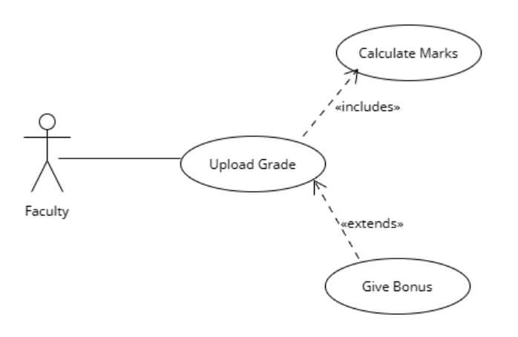
Relationships
Chapter 3: Use Case Diagram
MOHAIMEN-BIN-NOOR
S.8
MM
Dependency
<<include>>
Mandatory dependency
<< in >>, << i >>
Arrow towards the use case dependent on
<<extend>>
Optional Dependency
<< ex >>, << e >>
Arrow from the use case dependent on
Often referred as options of the use case

Slide 9
Chapter 3: Use Case Diagram
MOHAIMEN-BIN-NOOR
S.9
MM
Example of Use cases diagram
University Management System
Login
Registration of Course
Faculty
Student
Upload Grade

Slide 10
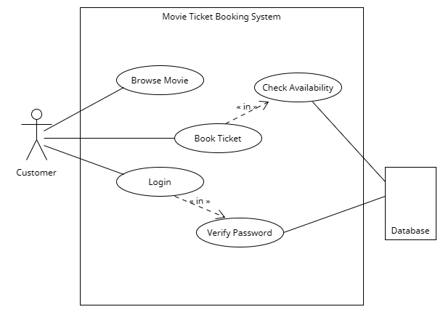
Chapter 3: Use Case Diagram
MOHAIMEN-BIN-NOOR
S.10
MM
Example of Use cases diagram

Slide 11
Chapter 3: Use Case Diagram
MOHAIMEN-BIN-NOOR
S.11
MM
Usage of Use case diagram
Use case diagrams are used to visualize, specify, construct, and document the (intended) behavior of the system, during requirements capture and analysis.
Provide a way for developers, domain experts, and end-users to Communicate.
Serve as basis for testing.
Use case diagrams contain use cases, actors, and their relationships.

